Slide 1
Strategic Plan
2014-17
The outline of a new framework

Slide 2
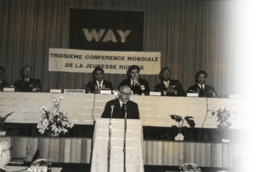
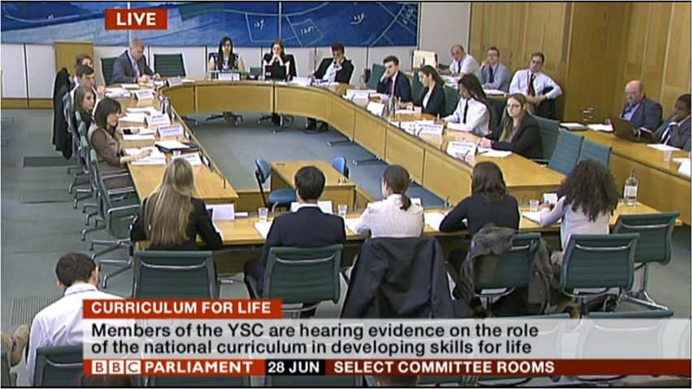
Our journey so far:
Established to represent Great Britain at the World Assembly of Youth in 1949…
…challenging those in power to listen to young people in 2013.

Slide 3
Our Vision:
A world where young people are respected and able to influence and inform decisions that affect them or on which they have strong views.

Slide 4
Our mission:
To be, as the national youth council of the United Kingdom, committed to ensuring that those aged 25 and under, are represented and participate fully and actively as citizens.
To inspire people about the positive contribution that young people can make to their communities, our nation and the world.
To empower young people with skills, knowledge and confidence to advance their rights and views to take part in decision-making.
To campaign with our members and those who share our values, for a better world that gives young people the recognition they deserve.

Slide 5
Our values:
Participation – We value meaningful participation of young people, enabling and empowering them to bring about better world for all
Inclusion – We value the inclusion of all , by working with young people from all backgrounds, cultures and ages to ensure a rich mix
Equality – We value all young people equally, promoting their rights equally, in the UK, and around the world.
Youth Leadership – We value and nurture youth leadership,
creating tomorrow’s leaders today for a better future.
Recognition – We value the recognition of young people’s achievements, publicly valuing them as part of our society.

Slide 6
Our model for change:
SOMETHING TO SAY
Facilitating and informing debate among young people, establishing collective views on the issues that matter to them.
+
WAYS TO SAY IT
Providing a range of opportunities for young people to represent their interests – through high-profile campaigns, democratic structures, traditional and social media - locally, nationally and internationally.
+
SOMEBODY LISTENING
Getting the attention and buy-in of decision makers, the media, business and our peers in society.
= YOUTH-LED CHANGE

Slide 7
Core themes
CAMPAIGNING
We will support young people to mobilise for change at local, national and international levels, providing them with information, skills, resources and platforms to promote their rights and represent their interests.
CITIZENSHIP
We will provide opportunities for young people to develop the capabilities of full and active citizens, preparing and connecting them, through representation and social action, to the political process.
RESEARCH
We will actively seek the informed views of young people on the issues of the day; we will position ourselves as the ‘go to’ organisation for youth views, working with our members to provide authentic spokespeople under 25.
RECOGNITION
We will celebrate and raise awareness of the positive contribution that young people can and do make to society, and champion those who treat young people as valued stakeholders, through awards, accreditation and publicity.

Slide 8
Enabling themes
MEMBERS
We will engage our members more fully in our work, developing a compelling offer and partnership opportunity for both individuals and local, national and international organisations to join us in advancing our mission.
RESOURCES
We will strive to secure resources that allows us to grow our core work sustainably without being dependent on any single source. We will be smart and strategic in developing relationships with funders, donors and partners.
PARTNERS
We recognise that we cannot realise our vision alone. We will actively seek out people and organisations who share our values and goals to broaden the scope and reach of our work, so that together we are more than the sum of our parts.
PROFILE
We will raise awareness of the British Youth Council, and its brands, growing our reputation for quality, and evidence-based outcomes from the participation of young people and providing a focal point and ‘go to’ platform for their views.

Slide 9
Enabling objective (1)
1. Membership: We will engage our members more fully in our work, developing a compelling offer and partnership opportunity for both individuals and local, national and international organisations to join us in advancing our mission.
Create a distinct role for individual young people engaging with BYC alongside our traditional membership of youth organisations.
Work with members to develop a stronger understanding of how their views and resources can be combined through BYC to support the interests of young people.
Enhance our relationships with member organisations to engage more of their young members directly in the activities of BYC.
Develop our communications strategy to increase the clarity, quality and frequency of two-way engagement with individuals and organisational members.
Continue to diversify our membership, making it more inclusive of groups that are currently under-represented, and support the active participation of all our members.
Celebrate the involvement and achievement of our members at all levels, recognising their contribution to the BYC’s vision for young people.

Slide 10
Enabling objective (2)
2. Resources: We will strive to secure resources that allow us to grow our core work sustainably without being dependent on any single source of income. We will be smart and strategic in developing relationships with funders, donors and partners.
Produce a fundraising strategy to support the achievement of our core objectives and invest in its implementation, reviewing it annually against organisational needs and context.
Establish close relationships between our staff, members and potential partners to capture and reuse organisational knowledge about effective fundraising.
Develop our alumni network of former staff, volunteers and trustees to increase our reach and identify new resources.
Continue to grow our income from training and consultancy activities in the UK and internationally.
Continue to work with government to protect the statutory funding that enables BYC to support the core structures of young people’s participation in democracy.
Explore and embrace “in kind” resources and the use of volunteers to meet our needs

Slide 11
Enabling objective (3)
3. Partners: We recognise that we cannot realise our vision alone. We will actively seek out people and organisations who share our values and goals to broaden the scope and reach of our work, so that together we are more than the sum of our parts.
Consider the partnerships that will enable us to deliver our core objectives, including national, devolved and local government, the voluntary sector and private companies.
Agree and implement a robust Ethical Partnerships Policy to hold ourselves and those we work with to the highest standards of conduct.
Join, form, and contribute to coalitions, groups or networks which will promote our campaigns and programmes more effectively.
Actively seek partnerships that enable us to include young people we might not otherwise reach through our network of members.
Work towards and facilitate, where possible, collective responses to policy makers or decision-makers, to increase our impact for young people

Slide 12
Enabling objective (4)
4. Profile: We will raise awareness of the British Youth Council, and its brands, growing our reputation for quality, and evidence-based outcomes from the participation of young people and providing a focal point and ‘go to’ platform for their views.
Raise the frequency, consistency and quality of our social media output, investing in the technology and the talent to enhance our messages.
Foster relationships in the online, print and broadcast media to ensure youth views feature regularly in mainstream commentary.
Work with our members to develop strong pipelines of well-informed young spokespeople, promoting the views of the British Youth Council.
Use our profile to promote greater recognition of young people’s achievements, and highlight their positive contribution to our society.
Ensure that we are included, formally and informally, in circles of influence across the sector and with decision-makers, defending the interests of young people.
Rigorously and openly measure our impact as an organisation and benchmark the quality of our work, sharing this with our stakeholders to encourage development and to celebrate success.

Slide 13
Core objectives (5)
5. Campaigning: We will support young people to mobilise for change at local, national and international levels, providing them with information, skills, resources and platforms to promote their rights and represent their interests.
Support young people to design and develop their own activities and campaigns, locally, nationally and internationally and Enhance the ways in which we collaborate with members to decide, plan and deliver campaigns with impact.
Explore and invest in modern campaigning platforms and tools, especially innovative online engagement.
Continuously learn from and promote best practice in campaigning, working with others to facilitate the transfer of knowledge and skills.

Slide 14
Core objectives (6)
6. Citizenship: We will provide opportunities for young people to develop the capabilities of full and active citizens, preparing and connecting them, through representation and social action, to the political process.
Promote and deliver learning materials and training that encourages engagement with the electoral process, particularly voter registration and for all age groups, link formal participation in democratic structures with wider social action, mobilising young people locally, nationally and internationally.
Continue to embed and integrate the representation structures established under the Youth Voice contract, working with members, partners and funders to promote under-19 participation and Develop the opportunities and platforms we offer to those between 18 and 25 to support the transition to full citizenship, drawing upon the depth of skills and experience in this age group.

Slide 15
Core objectives (7)
7. Research: We will actively seek the informed views of young people on the issues of the day; we will position ourselves as the ‘go to’ organisation for youth views, working with our members to provide authentic spokespeople under 25.
Develop, on the basis of credible evidence, strong, clear and specific recommendations for change, e.g. to government.
Work in partnership with other research organisations (pollsters, think tanks) to provide original research into the issues that matter most to young people.
Use innovative, participatory methods to capture the richness and diversity of perspectives held by young people and use these to inform our work and Enhance our capacity and reputation for surveying youth views, using this in our own work and as a result of commissions from partner organisations, including our members.
Produce openly-available background and factual information on a range of topics to provide young people with the information they need to make informed decisions, strictly maintaining our impartiality and objectivity

Slide 16
Core objectives (8)
8. Recognition: We will celebrate and raise awareness of the positive contribution that young people can and do make to society, and champion those who treat young people as valued stakeholders, through awards, accreditation and publicity
Provide opportunities for young people to inspire each other to act for positive social change, particularly addressing the barriers of resources, confidence and ability that some young people may face.
Develop a media strategy that targets new and traditional media with examples of young people fulfilling their roles as citizens, taking part in social action and informing civic debate and Continue to combat the misrepresentation of young people in the mainstream media, by producing and actively disseminating ‘positive stories’, using the authentic voices of young people.
Use our award programmes to increase the recognition that we give to organisations that, though not youth-led, treat young people as partners and give them positions of influence.

